Slide 1
National University of Lesotho,
Southern Africa
Durability and effectiveness of isoniazid preventive therapy in Lesotho, southern Africa
Eltony Mugomeri
www.aids2018.org
22nd International AIDS Conference (AIDS 2018) Amsterdam, Netherlands, 23-27 July 2018

Slide 2
Global TB Hot Spots, 2016
Global Tuberculosis Report (2017)
Eltony Mugomeri emugomeri@yahoo.com

Slide 3
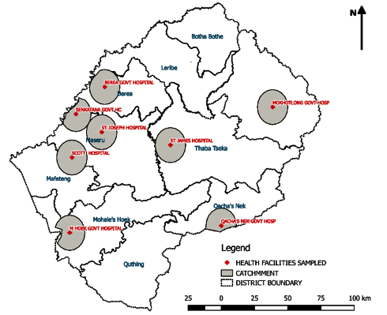
Global TB Hot Spots, 2016
Lesotho
Global Tuberculosis Report (2017)
Eltony Mugomeri emugomeri@yahoo.com

Slide 4
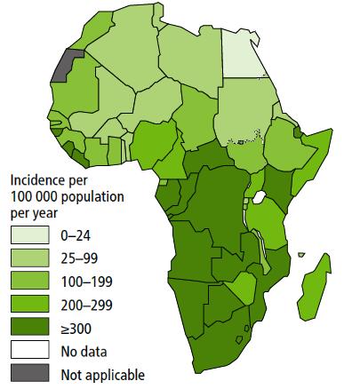
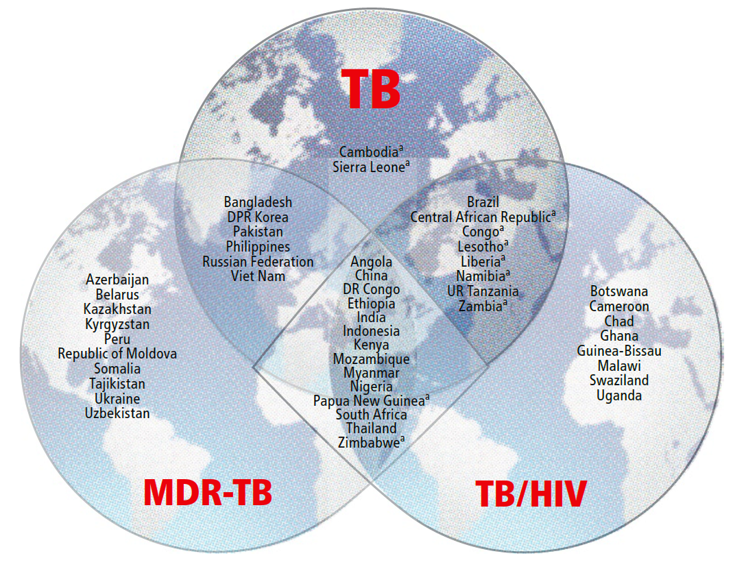
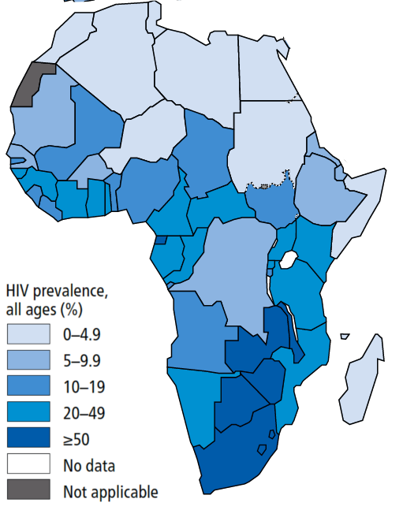
HIV/TB syndemic in sub-Saharan Africa
TB incidence, 2016
HIV rates in TB cases, 2016
Global Tuberculosis Report (2017)
PLHIV in SSA largest reservoir of TB globally (74% of all annual infections).
(Hermans et al, 2016).
How effective is universal IPT (all HIV+) in high HIV/TB burden settings?
Eltony Mugomeri emugomeri@yahoo.com

Slide 5
HIV/TB syndemic in sub-Saharan Africa
TB incidence, 2016
HIV rates in TB cases, 2016
Global Tuberculosis Report (2017)
PLHIV in SSA largest reservoir of TB globally (74% of all annual infections).
(Hermans et al, 2016).
How effective is universal IPT (all HIV+) in high HIV/TB burden settings?
Eltony Mugomeri emugomeri@yahoo.com

Slide 6
Provision of IPT to PLHIV, 2005-2014
WHO, 2014
WHO recommended 6 month IPT course for PLHIV in 2004.
Sluggish uptake of IPT common in SSA where needed most
Eltony Mugomeri emugomeri@yahoo.com

Slide 7
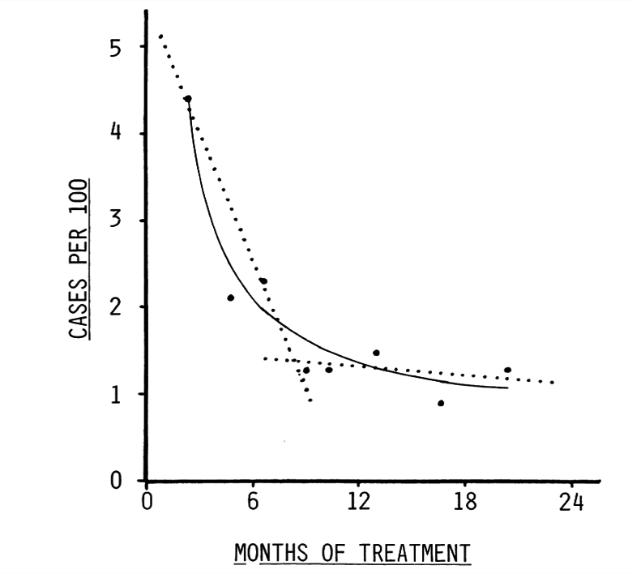
Efficacy of IPT in clinical trials
Comstock (1999)
Eltony Mugomeri emugomeri@yahoo.com

Slide 8
Efficacy of IPT in clinical trials
Optimum IPT course (Clinical Trials)
36 months IPT = 3 yrs protection (Martinson et al, 2009 [S.Africa]; Samandari et al, 2011 [Botswana]).
6 months IPT = 6 months protection (Rangaka et al, 2014) in S. Africa where IPT reduced TB incidence by 60% in HIV+ adults with no history of TB.
Rifampicin & pyrazinamide?
How effective is universal IPT?
Comstock (1999)
Eltony Mugomeri emugomeri@yahoo.com

Slide 9
Lesotho’s HIV/TB situation
HIV+ = 23.5% (adults) & TB incidence = 852 per 100,000 (WHO, 2016);
> 700 per 100,000 alongside S. Africa & Swaziland
74% of TB+ co-infected with HIV (WHO, 2014).
TB incidence & notification rates, Lesotho?
Eltony Mugomeri emugomeri@yahoo.com

Slide 10
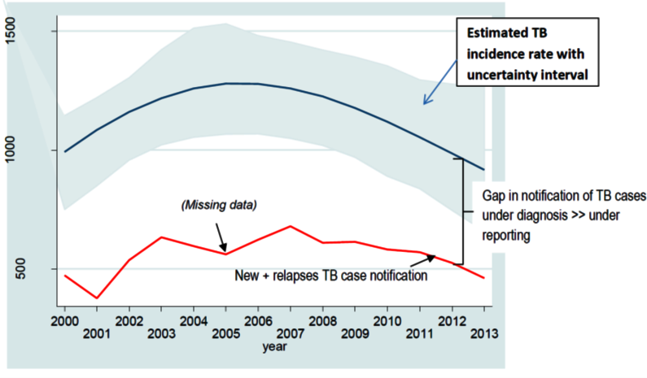
Lesotho’s HIV/TB situation
HIV+ = 23.5% (adults) & TB incidence = 852 per 100,000 (WHO, 2016);
> 700 per 100,000 alongside S. Africa & Swaziland
74% of TB+ co-infected with HIV (WHO, 2014).
TB incidence & notification rates, Lesotho?
TB incidence & notification rates, Lesotho? (2000-2013)
Eltony Mugomeri emugomeri@yahoo.com

Slide 11
Lesotho’s HIV/TB situation
Poor TB treatment outcomes persist
TB treatment outcomes (2016) by category (a) and overall (b) (n = 812).
Southern African Journal of Infectious Diseases, 33:1, 18-23,
Eltony Mugomeri emugomeri@yahoo.com

Slide 12
Lesotho’s HIV/TB situation
Poor TB treatment outcomes persist
TB treatment outcomes (2016) by category (a) and overall (b) (n = 812).
Southern African Journal of Infectious Diseases, 33:1, 18-23,
Eltony Mugomeri emugomeri@yahoo.com

Slide 13
Lesotho’s HIV/TB situation
Poor TB treatment outcomes persist
Defaulted
Rx Failure
TB treatment outcomes (2016) by category (a) and overall (b) (n = 812).
Southern African Journal of Infectious Diseases, 33:1, 18-23,
Eltony Mugomeri emugomeri@yahoo.com

Slide 14
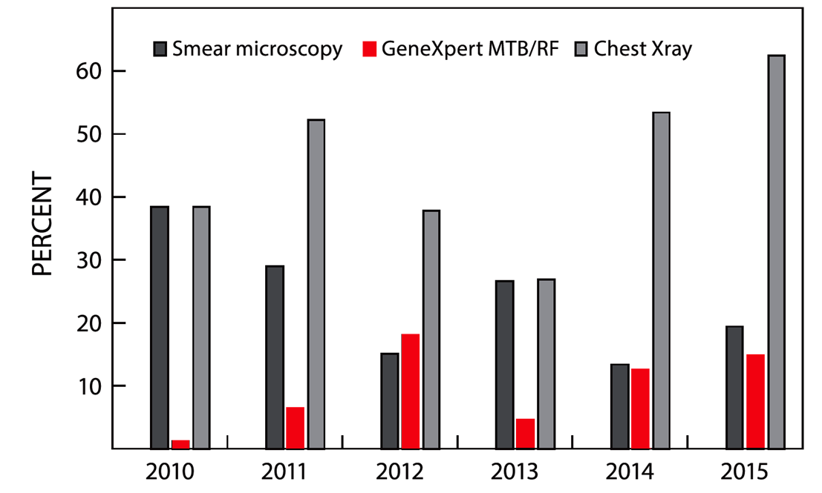
Diagnostic techniques for TB in Lesotho
Poor scale-up of GeneXpert (Mugomeri et al, 2017)
Southern African Journal of Infectious Diseases, 33:1, 18-23,
Eltony Mugomeri emugomeri@yahoo.com

Slide 15
Sampling criteria
METHODS
Stratified systematic random sampling
PLHIV (2004 – 2016) from eight district hospitals (three in sparse & five in densely inhabited districts).
Eltony Mugomeri emugomeri@yahoo.com

Slide 16
Data Collection
METHODS
HIV-positive children, adolescents, adults, geriatric & pregnant in 2 cohorts (Before & after IPT launch.) NB. Lesotho launched IPT in 2011.
Discrete-time survival data (6-month intervals).
Eltony Mugomeri emugomeri@yahoo.com

Slide 17
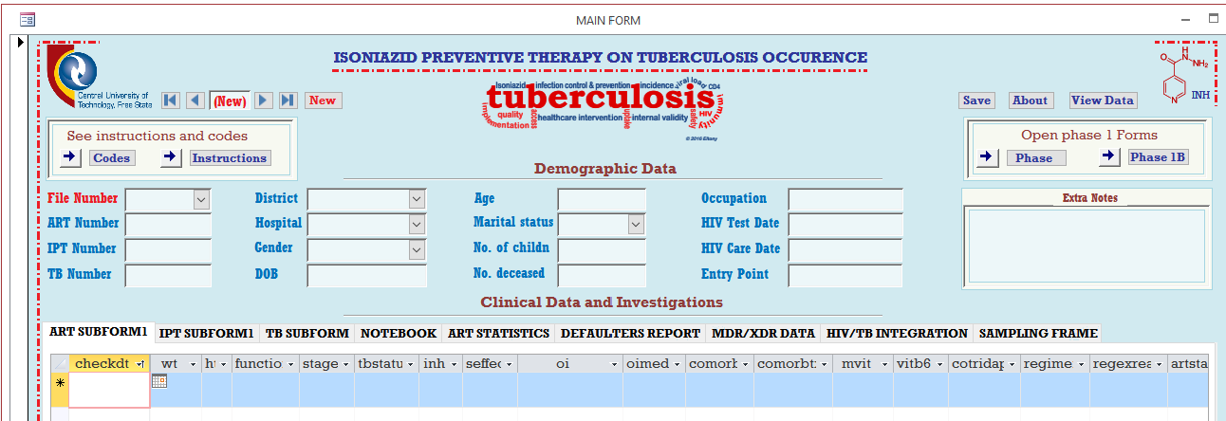
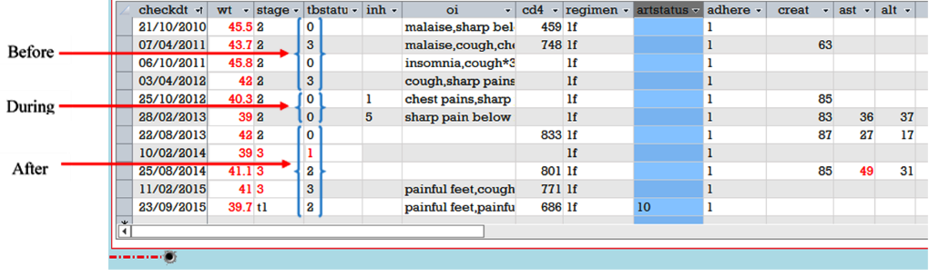
Data Abstraction Tool
Microsoft Access Relational Database Tool (SQL patient profiling)
TB Status Key
0 | No TB signs
1 | Active TB
2 | Past TB
3 | TB signs
INH Key
1 | Begin IPT
5 | Completed
Regimen Key
1f | tenofovir
Eltony Mugomeri emugomeri@yahoo.com

Slide 18
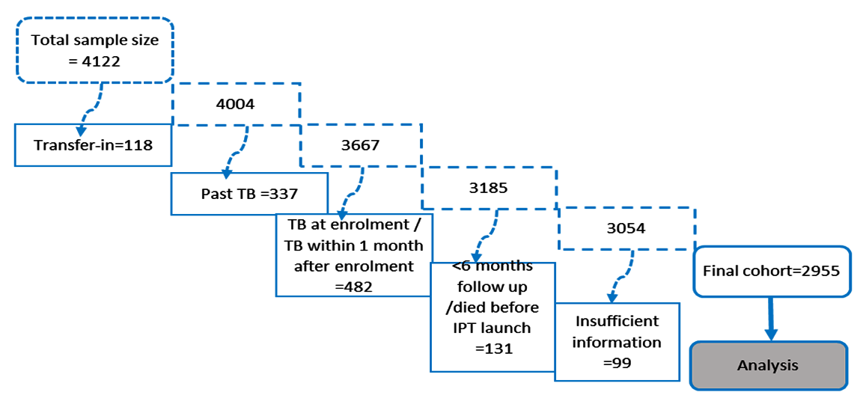
Final sample size
METHODS
Analysis?
Eltony Mugomeri emugomeri@yahoo.com

Slide 19
Final sample size
METHODS
Analysis
Cox’s proportional hazard regression model for TB occurrence in Stata®
Eltony Mugomeri emugomeri@yahoo.com

Slide 20
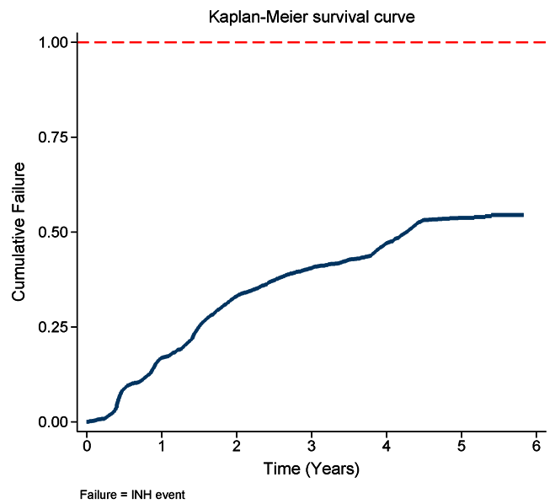
RESULTS
Rate of initiation on IPT
68.8% of 2,955 sample had received IPT by study exit time (Dec 2016).
IPT initiation was 20.6 per 100 person-years, with 135 (6.6%) defaults.
Slow IPT initiation?
Overall cumulative IPT uptake, 2011-2016
Eltony Mugomeri emugomeri@yahoo.com

Slide 21
RESULTS
Rate of initiation on IPT
68.8% of 2,955 sample had received IPT by study exit time (Dec 2016).
IPT initiation was 20.6 per 100 person-years, with 135 (6.6%) defaults.
Slow IPT initiation: Children/adolescents, higher population density and longer duration of ART>=5 years
Overall cumulative IPT uptake, 2011-2016
Eltony Mugomeri emugomeri@yahoo.com

Slide 22
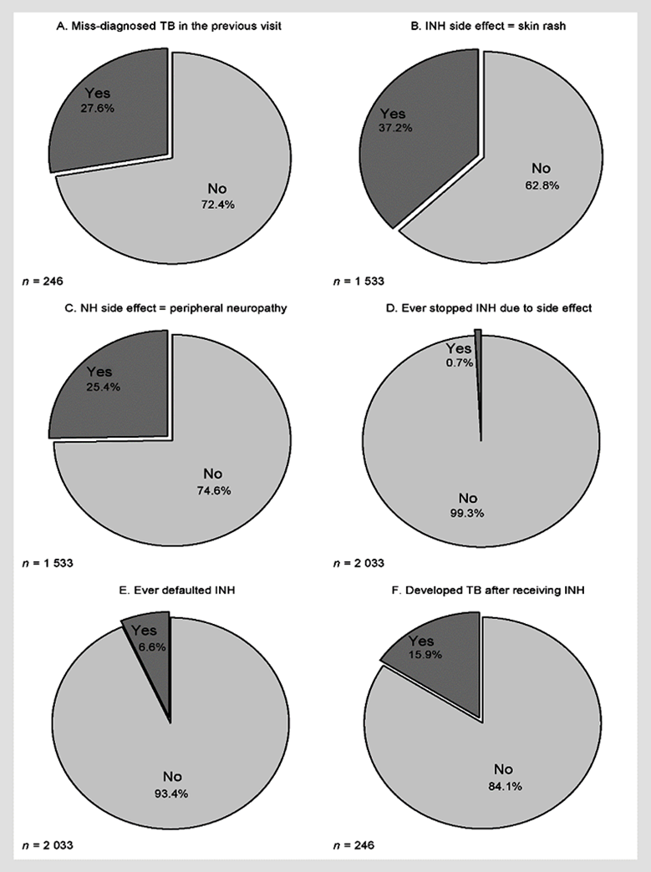
TB Miss-diagnosis & IPT side effects still a problem
Miss-diagnosis of TB persists
Side effects
IPT defaulting?
Patients in the sparsely populated districts (aOR)=1.6] and males [aOR=2.1] had significantly (p<0.005) higher rates of defaulting IPT compared to those in the densely populated districts and females, respectively.
Eltony Mugomeri emugomeri@yahoo.com

Slide 23
IPT treatment outcomes
Miss-diagnosis of TB persists
Side effects
IPT defaulting
Patients in the sparsely populated districts (aOR)=1.6] and males [aOR=2.1] had significantly (p<0.005) higher rates of defaulting IPT compared to those in the densely populated districts and females, respectively.
Eltony Mugomeri emugomeri@yahoo.com

Slide 24
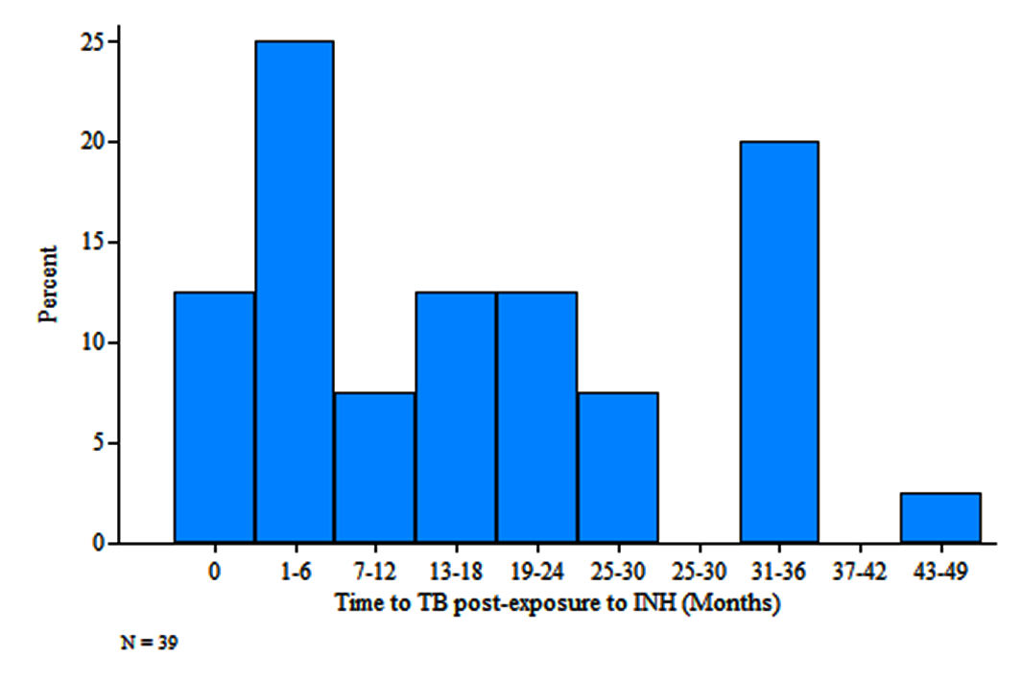
Time to TB event in IPT-exposed cohort
Thirty-nine (15.9%, n = 246) patients developed TB after IPT
Eltony Mugomeri emugomeri@yahoo.com

Slide 25
Time to TB event in IPT-exposed cohort
Miss-diagnosed TB
Thirty-nine (15.9%, n = 246) patients developed TB after IPT
Eltony Mugomeri emugomeri@yahoo.com

Slide 26
Effectiveness of IPT in Lesotho
TB incidences per 100 person-years by timing of IPT:
IPT before ART (1.7),
IPT after ART (1.8),
no IPT (2.6),
IPT within one year of ART commencement (1.3) &
IPT 3-5 years after ART initiation (2.3).
Eltony Mugomeri emugomeri@yahoo.com

Slide 27
Effectiveness of IPT in Lesotho
Eltony Mugomeri emugomeri@yahoo.com

Slide 28
Effectiveness of IPT in Lesotho
Loss of protection
Need to check resistance in cohort?
Eltony Mugomeri emugomeri@yahoo.com

Slide 29
Predictor variables for TB event
Eltony Mugomeri emugomeri@yahoo.com

Slide 30
Predictor variables for TB event
Eltony Mugomeri emugomeri@yahoo.com

Slide 31
Significant Predictor variables for TB event
Based on Wilcoxon’s log-rank test (Categorical) and Cox regression analysis (Continuous)
Gender,
Baseline WHO clinical stage,
District category,
Time to IPT relative to ART commencement (Continuous variable)
Eltony Mugomeri emugomeri@yahoo.com

Slide 32
Eltony Mugomeri emugomeri@yahoo.com

Slide 33
Increasing time to IPT by one six-month interval increased the risk of contracting TB by between 6% and 59%, depending on the cohort.
NB. Slight variation when factor interaction is considered
Eltony Mugomeri emugomeri@yahoo.com

Slide 34
CONCLUSION
*Effectiveness of IPT depends on ‘Time to IPT relative to ART commencement’
Ethiopia study: IPT-before-ART (aHR = 0.18, 95% CI = 0.08–0.42) better than simultaneously with ART (aHR = 0.20, 95% CI = 0.10–0.42) (Yardaw et al, 2014)
*High risk of reinfection in high TB Burden settings
Compared to no IPT, combined IPT and ART reduces the risk of contracting TB by 37% (HR = 0.63, 95 % CI 0.41-0.94) IPT (Rangaka et al. 2014) in S.A;
60 % (HR = 0.40; 95 % CI 0.18 - 0.87) (Ayele et al, 2015) in Ethiopia;
Six months IPT = six months protection? (Rangaka et al, 2014) in S. Africa.
*Booster doses needed
Brazil: Six-month IPT course reduces the risk of contracting TB for at least seven years? Golub et al. (2015)

Slide 35
National University of Lesotho,
Southern Africa
-Thank You-
Acknowledgements
D. Olivier and W. M.J. van den Heever
Central University of Technology, Free State, SA
“To arrive inductively at laws of [of influence], ... all that is required is a series of careful and exact measures in every different state of the datum and quaesitum.”
Herschel in Residuals and Influence in Regresson (Cook & Weisberg, 1982)
Eltony Mugomeri emugomeri@yahoo.com

